Slide 1
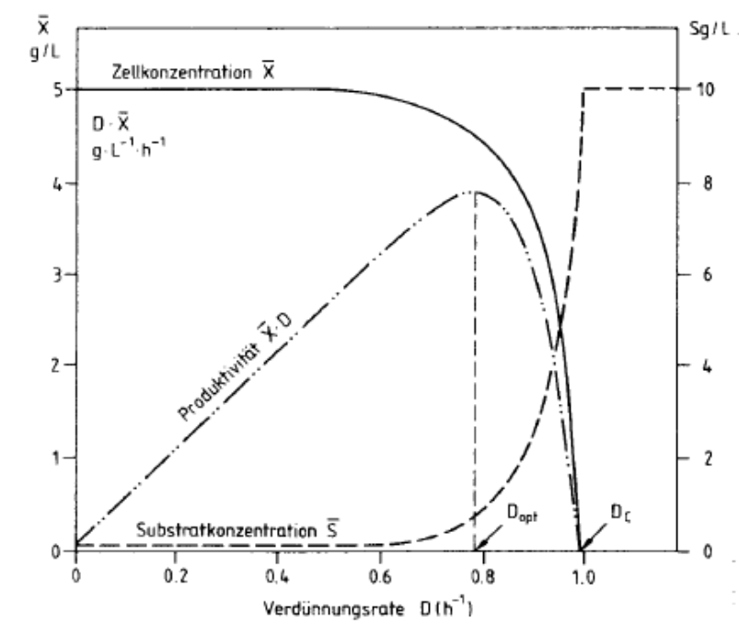
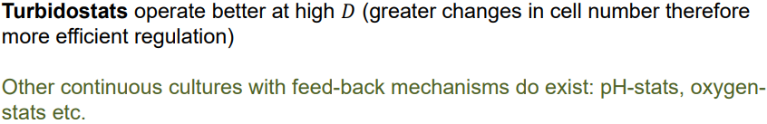
1) Chemostat Theory
Draw a x-D diagram with consideration of maintenance energy and insert, biomass, volumetric productivity, specific productivity, residual glucose concentration s, D_{opt} and D_{crit}.
What do you understand under a turbidostat and a pH auxostat?
In other techniques, a fermenter variable, e.g. turbidity or pH, will be monitored using an appropriate detector and the liquid flow rate will be automatically adjusted so as to maintain the variable at a constant level (closed loop control)
What are their differences to a chemostat?
The dilution rate is not constant, the specific growth rate of the cells is close to μ_{max}. Tricky to run in a stable way (fast analytics needed and good algorithms).
Figure 1: The purple function corresponds to the specific productivity $q_{P}=μ/Y_{X/S}$

Slide 2
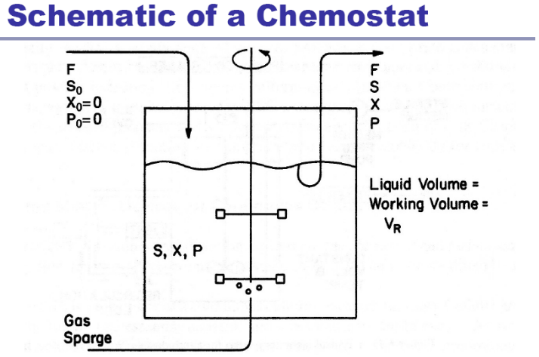
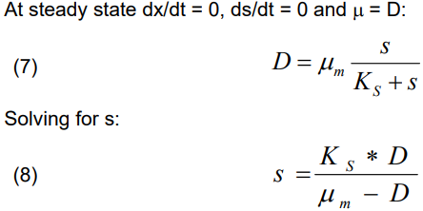
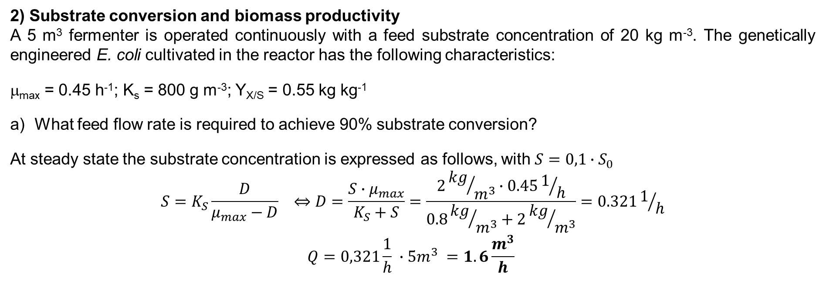
2) Substrate conversion and biomass productivity
A 5 m³ fermenter is operated continuously with a feed substrate concentration of 20 kg m⁻³. The genetically engineered E. coli cultivated in the reactor has the following characteristics:
μ_{max} = 0.45 h⁻¹; K_{s} = 800 g m⁻³; Y_{X/S} = 0.55 kg kg⁻¹
What feed flow rate is required to achieve 90% substrate conversion?
At steady state the substrate concentration is expressed as follows, with $S=0,1∙S_{0}$
$$S=K_{S}\frac{D}{μ_{max}−D} ⇔D=\frac{S∙μ_{max}}{K_{S}+S}=\frac{2{kg}/{m^{3}}∙0.451/h}{0.8{kg}/{m^{3}}+2{kg}/{m^{3}}}=0.3211/h$$
$$Q=0,321\frac{1}{h} ∙5m^{3} =1.6\frac{m^{3}}{h}$$

Slide 3
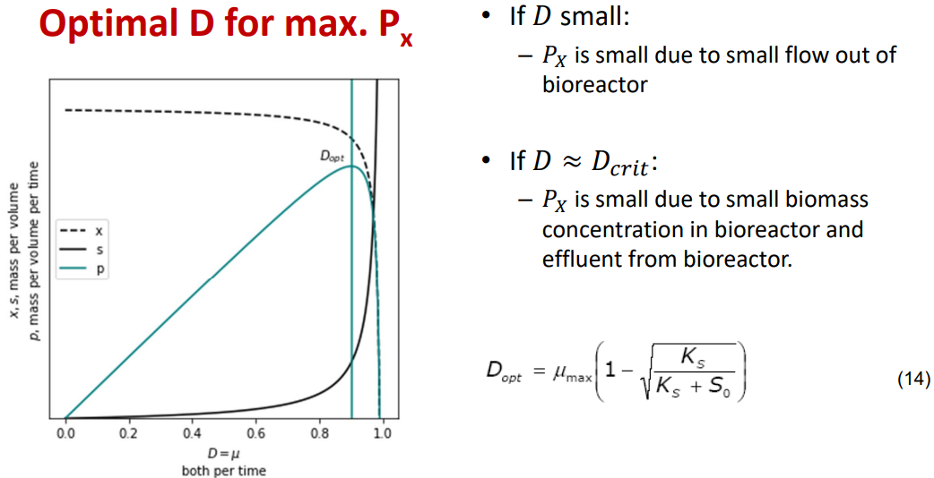
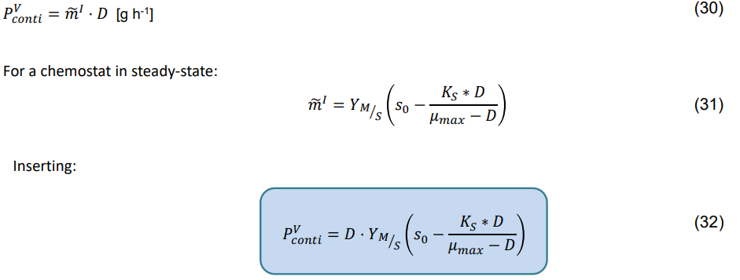
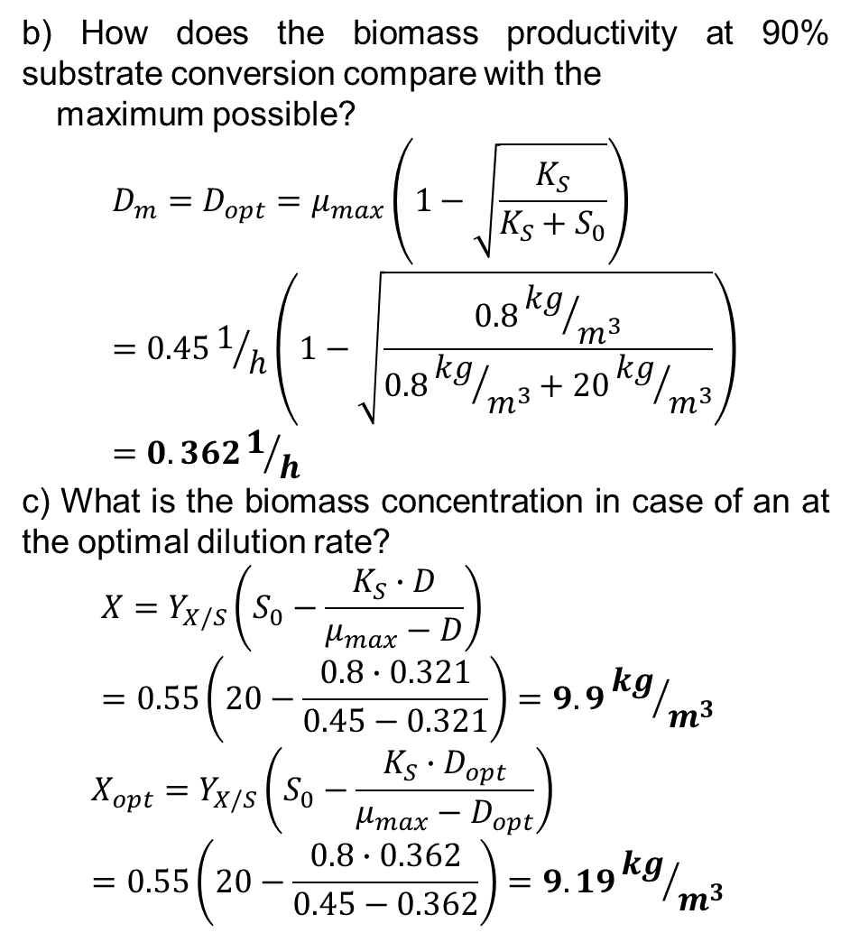
b) How does the biomass productivity at 90% substrate conversion compare with the
maximum possible?
$$D_{m}=D_{opt}=μ_{max}\left(1−\sqrt{\frac{K_{S}}{K_{S}+S_{0}}}\right)=0.451/h\left(1−\sqrt{\frac{0.8{kg}/{m^{3}}}{0.8{kg}/{m^{3}}+20{kg}/{m^{3}}}}\right)=0.3621/h$$
c) What is the biomass concentration in case of an at the optimal dilution rate?
$$X=Y_{X/S}\left(S_{0}−\frac{K_{S}∙D}{μ_{max}−D}\right)=0.55\left(20−\frac{0.8∙0.321}{0.45−0.321}\right)=9.9{kg}/{m^{3}}$$
$$X_{opt}=Y_{X/S}\left(S_{0}−\frac{K_{S}∙D_{opt}}{μ_{max}−D_{opt}}\right)=0.55\left(20−\frac{0.8∙0.362}{0.45−0.362}\right)=9.19{kg}/{m^{3}}$$

Slide 4
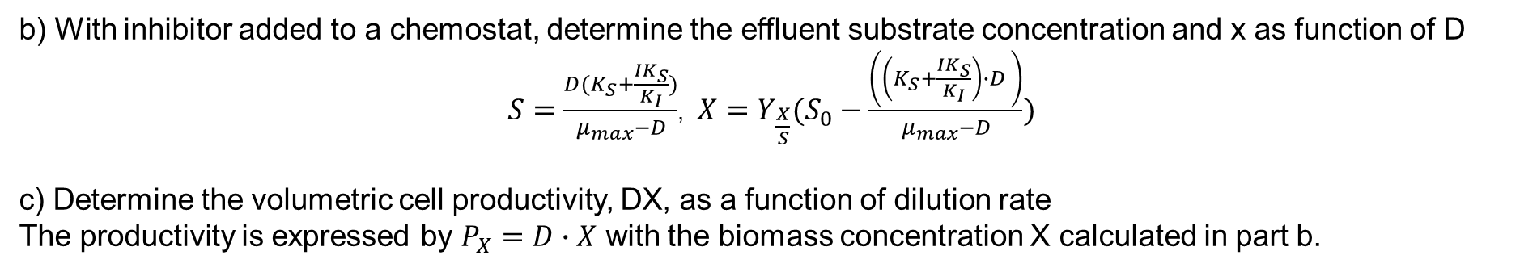
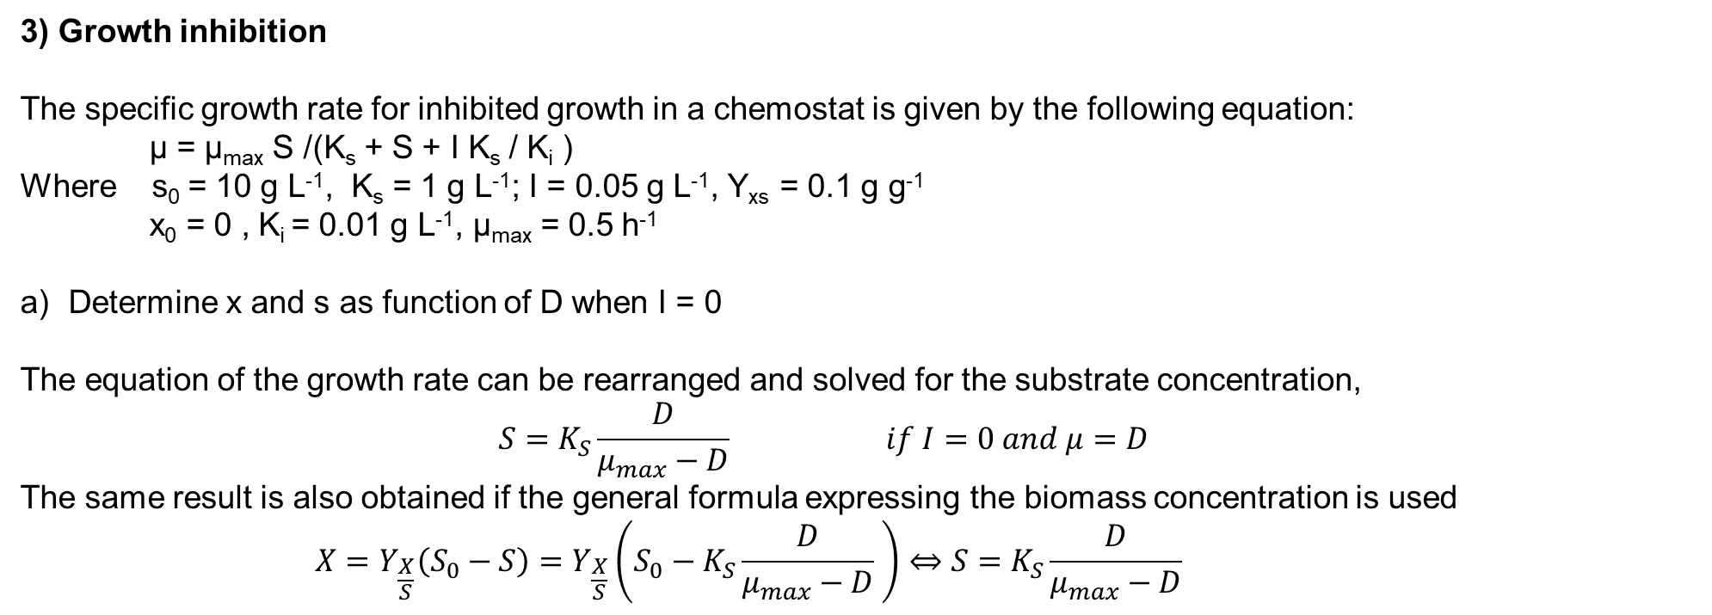
3) Growth inhibition
The specific growth rate for inhibited growth in a chemostat is given by the following equation:
µ = µ_{max} S /(K_{s} + S + I K_{s} / K_{i} )
Where s₀ = 10 g L⁻¹, K_{s} = 1 g L⁻¹; I = 0.05 g L⁻¹, Y_{xs} = 0.1 g g⁻¹
x₀ = 0 , K_{i} = 0.01 g L⁻¹, µ_{max} = 0.5 h⁻¹
Determine x and s as function of D when I = 0
The equation of the growth rate can be rearranged and solved for the substrate concentration,
$$S=K_{S}\frac{D}{μ_{max}−D} if I=0 and μ=D$$
The same result is also obtained if the general formula expressing the biomass concentration is used
$$X=Y_{\frac{X}{S}}\left(S_{0}−S\right)=Y_{\frac{X}{S}}\left(S_{0}−K_{S}\frac{D}{μ_{max}−D} \right)⇔S=K_{S}\frac{D}{μ_{max}−D}$$
b) With inhibitor added to a chemostat, determine the effluent substrate concentration and x as function of D
$S=\frac{D(K_{S}+\frac{IK_{S}}{K_{I}})}{μ_{max}−D}$, $X=Y_{\frac{X}{S}}(S_{0}−\frac{\left(\left(K_{S}+\frac{IK_{S}}{K_{I}}\right)∙D \right)}{μ_{max}−D})$
c) Determine the volumetric cell productivity, DX, as a function of dilution rate
The productivity is expressed by $P_{X}=D∙X$ with the biomass concentration X calculated in part b.

Slide 5
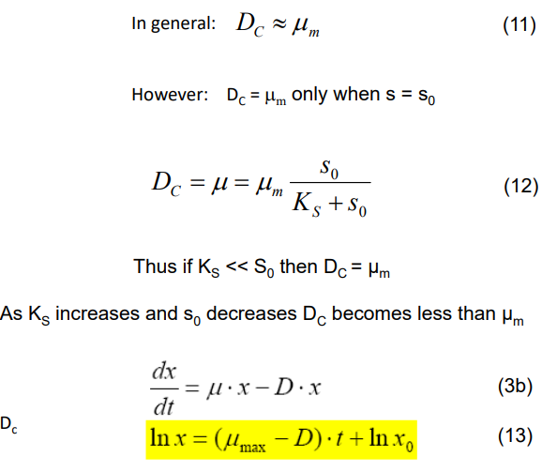
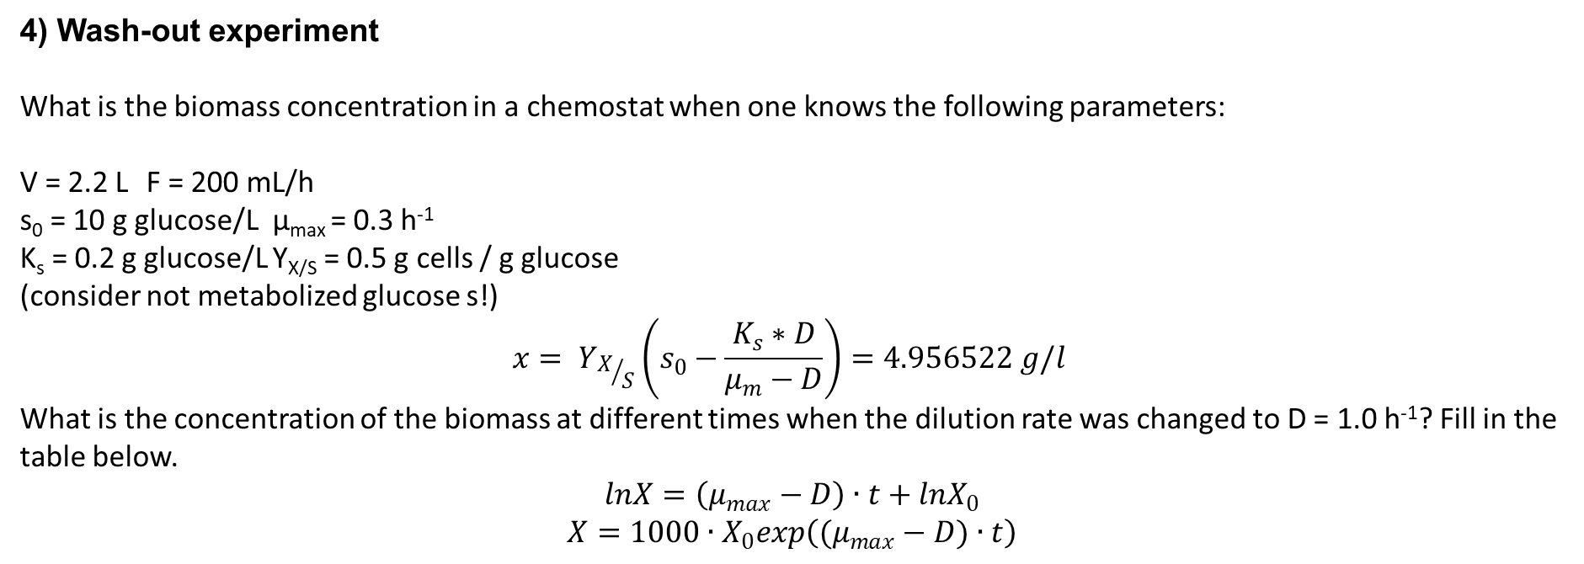
4) Wash-out experiment
What is the biomass concentration in a chemostat when one knows the following parameters:
V = 2.2 L F = 200 mL/h
s₀ = 10 g glucose/L µ_{max} = 0.3 h⁻¹
K_{s} = 0.2 g glucose/L Y_{X/S} = 0.5 g cells / g glucose
(consider not metabolized glucose s!)
$$x= Y_{X/S}\left(s_{0}−\frac{K_{s}∗D}{μ_{m}−D}\right)=4.956522 g/l$$
What is the concentration of the biomass at different times when the dilution rate was changed to D = 1.0 h⁻¹? Fill in the table below.
$$lnX=\left(μ_{max}−D\right)∙t+lnX_{0}$$
$$X=1000∙X_{0}exp\left((μ_{max}−D)∙t\right)$$
Time [h] | Biomass concentration [mg L⁻¹] (3 digits after the comma !)
1 | 2461.336
5 | 149.674
15 | 0.136
25 | 0.000

